Slide 1

FLOW FROM EXISTING APP –
WHAT WORK IS NEEDED

Slide 2
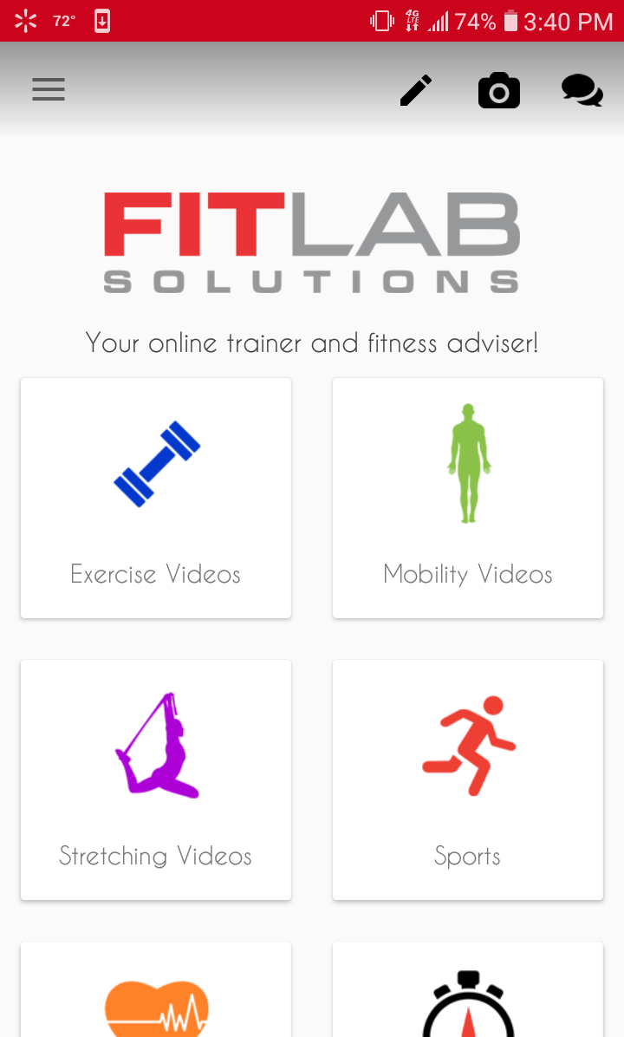
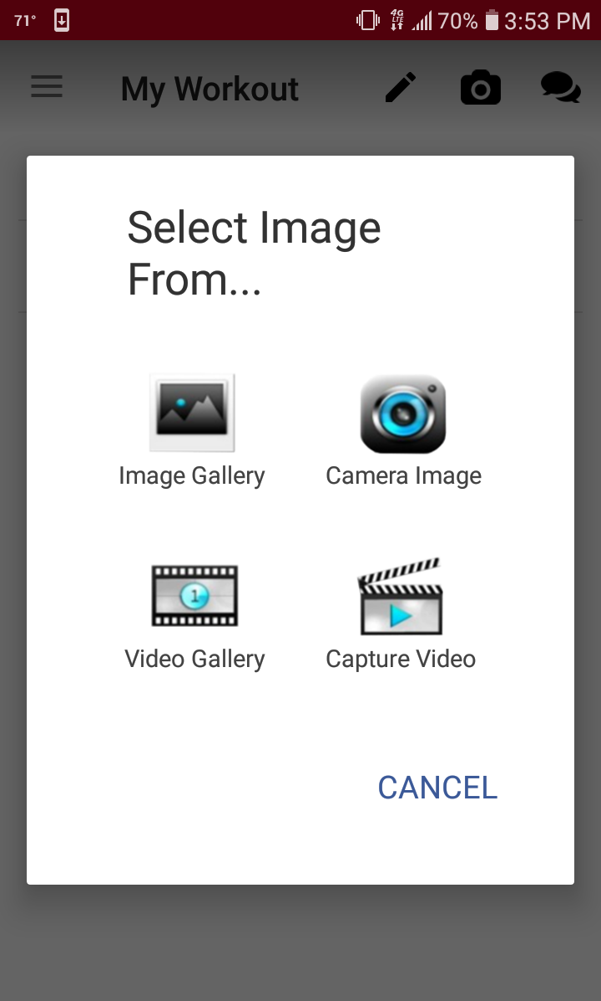
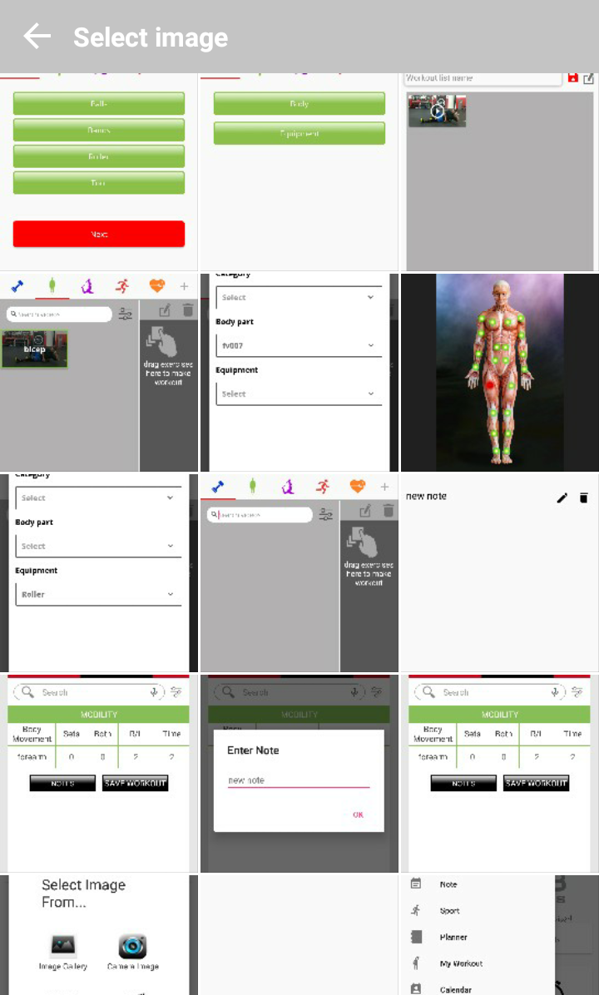
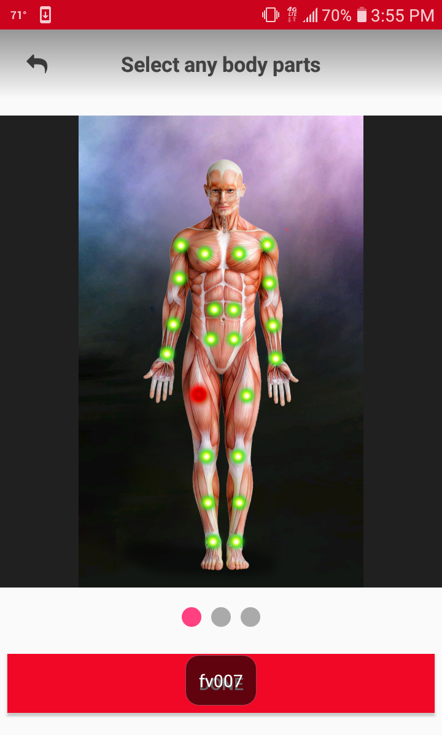
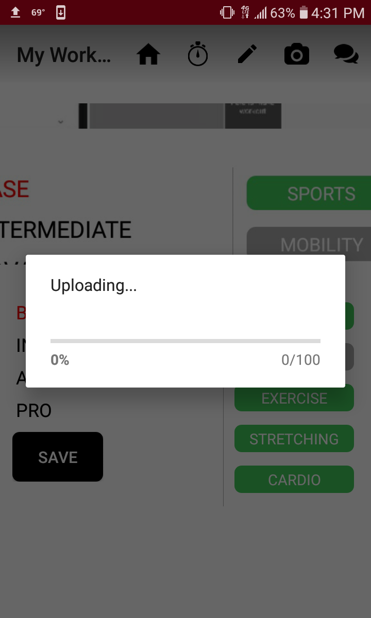
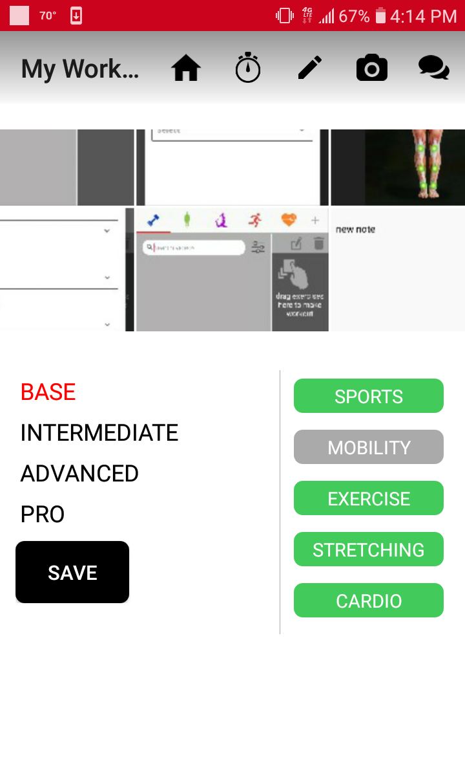
Currently, the flow for uploading and image/video is as follows:
(Flow is same for all options)
(Selects image)
NEEDS
TO BE
CHANGED
(NEXT
SLIDE)

Slide 3
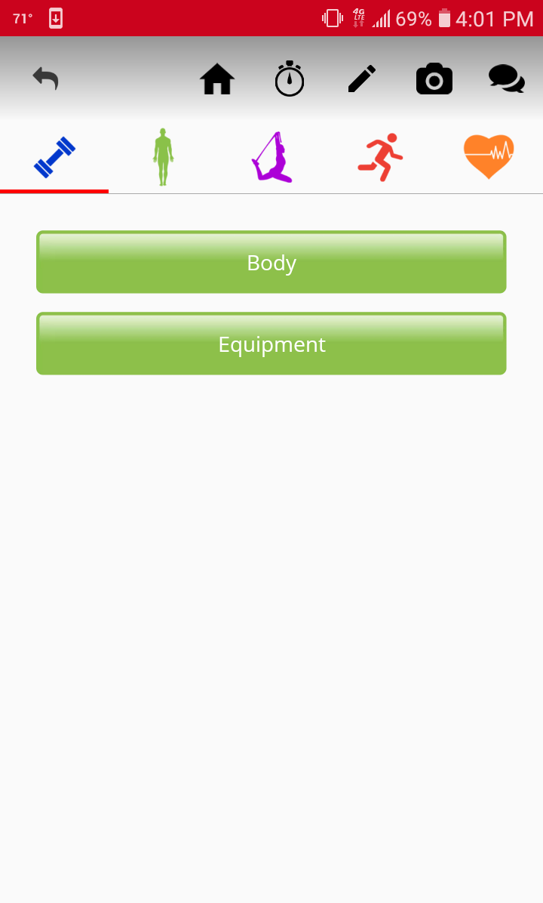
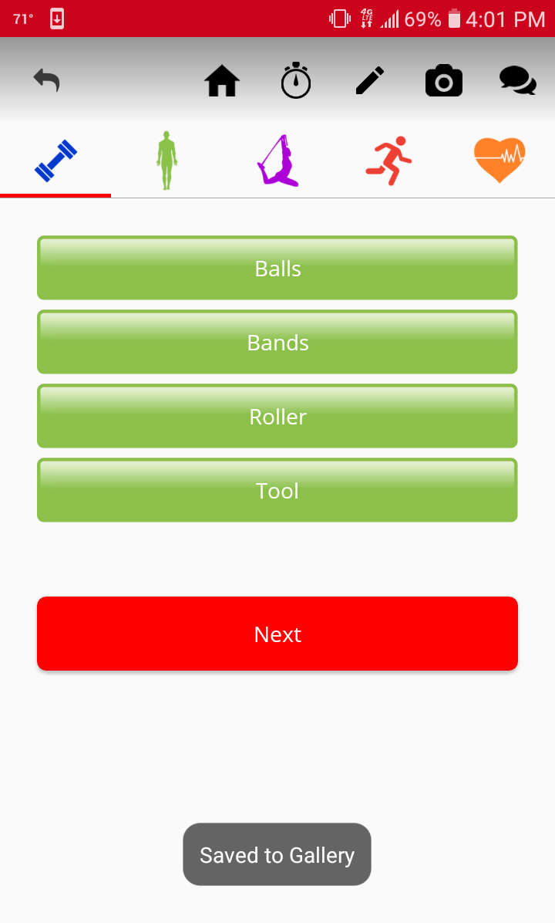
AFTER THEY SELECT AN IMAGE, NEED TO BE ABLE TO SELECT BOTH BODY AND EQUIPMENT
ALLOW FOR BOTH
TO BE SELECTED
NEXT
ONE SCREEN WILL GO TO THE NEXT BEFORE SAVING,
WILL UPLOAD UNDER ALL CATEGORIES FOR BODY PARTS AND EQUIPMENT

Slide 4
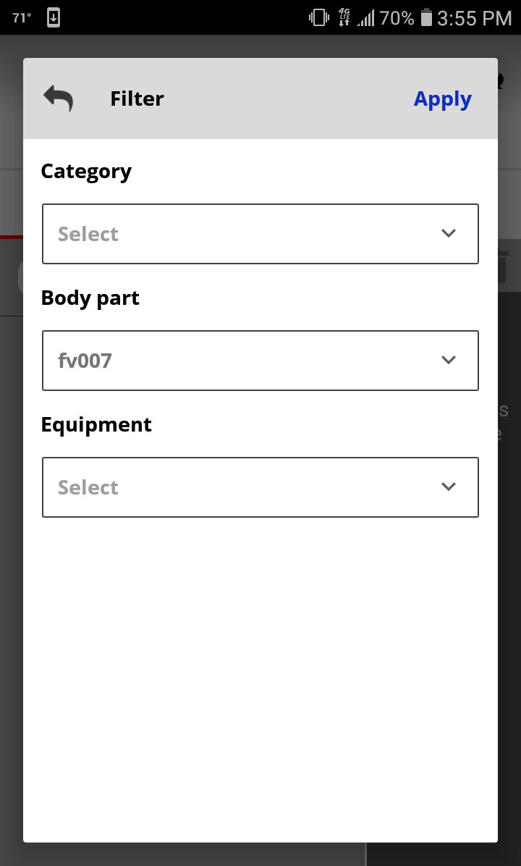
NEED TO REPLACE WITH ACTUAL NAME OF BODY PART

Slide 5
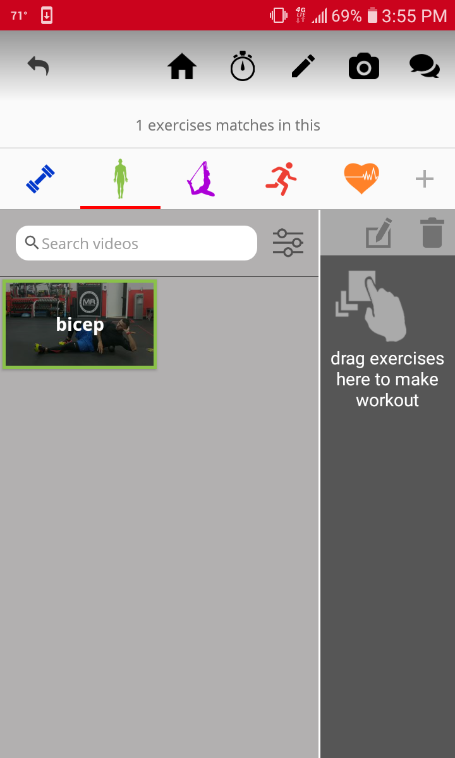
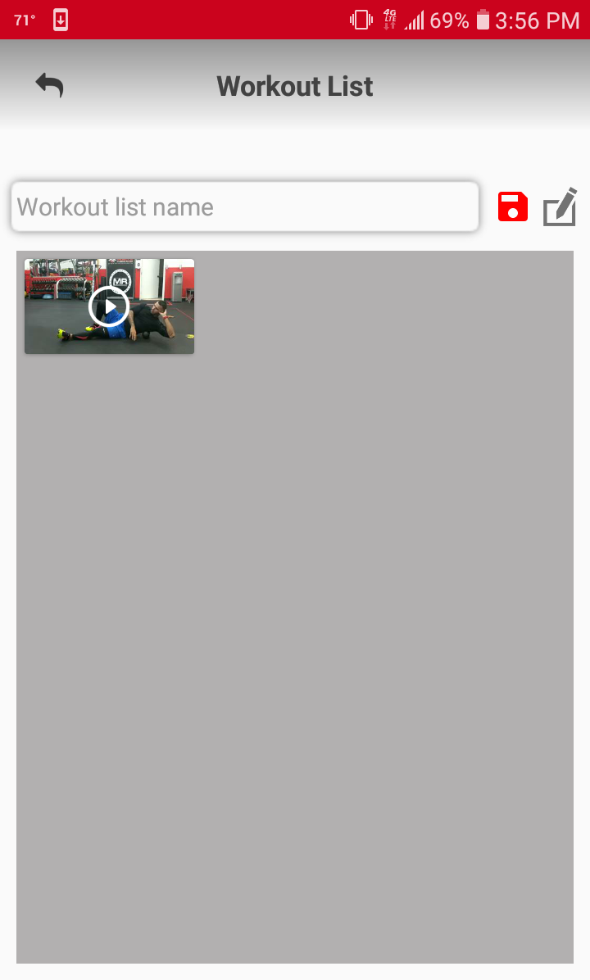
MORE VIDEOS NEED TO BE UPLOADED
VIDEOS NEED TO BE CATEGORIZED PROPERLY UNDER CATEGORY, BODY PART, EQUIPMENT
VIDEO BORDERS NEED TO CHANGE WHETHER PULLED UP UNDER EXERCISE, MOBILITY, STRETCHING, CARDIO

Slide 6
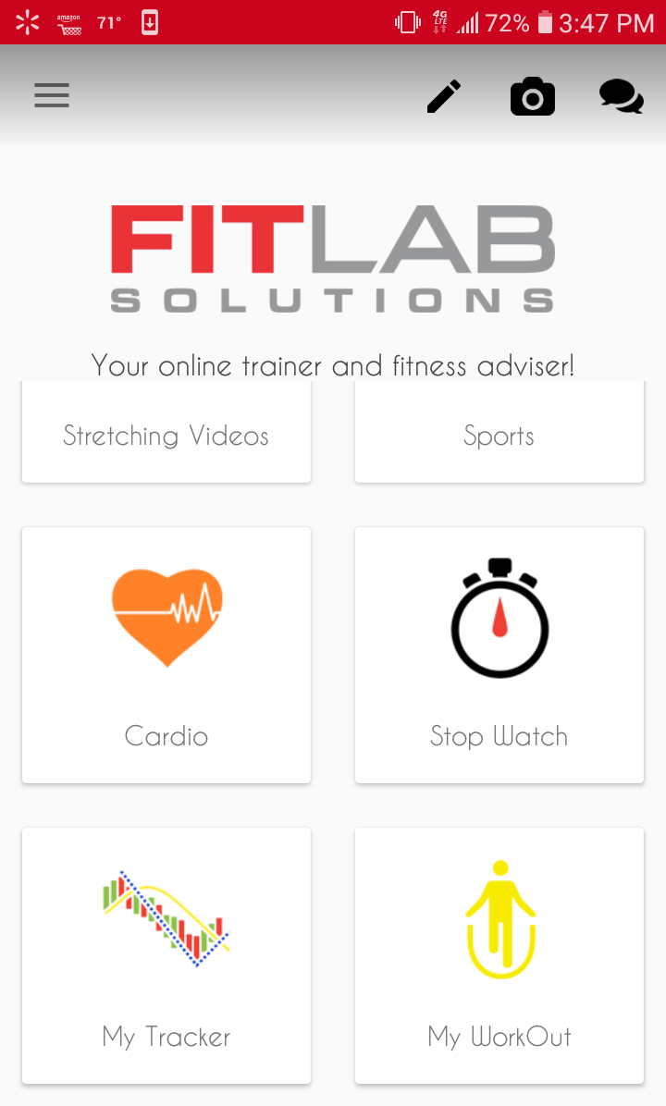
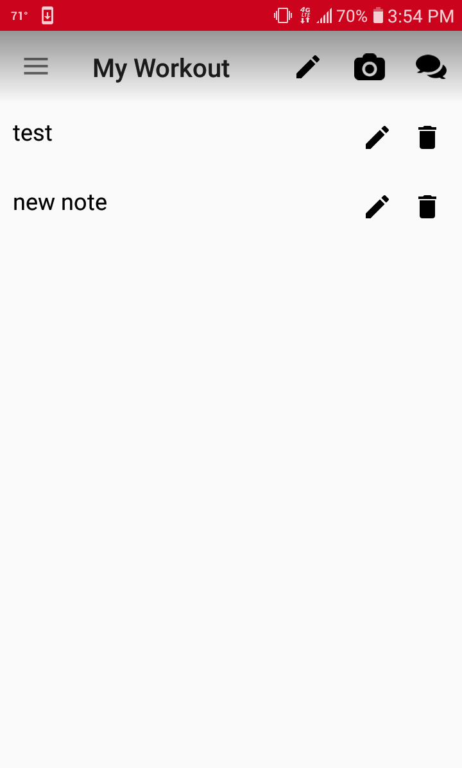
WORKOUT NAMES NEED TO BE EDITABLE

Slide 7
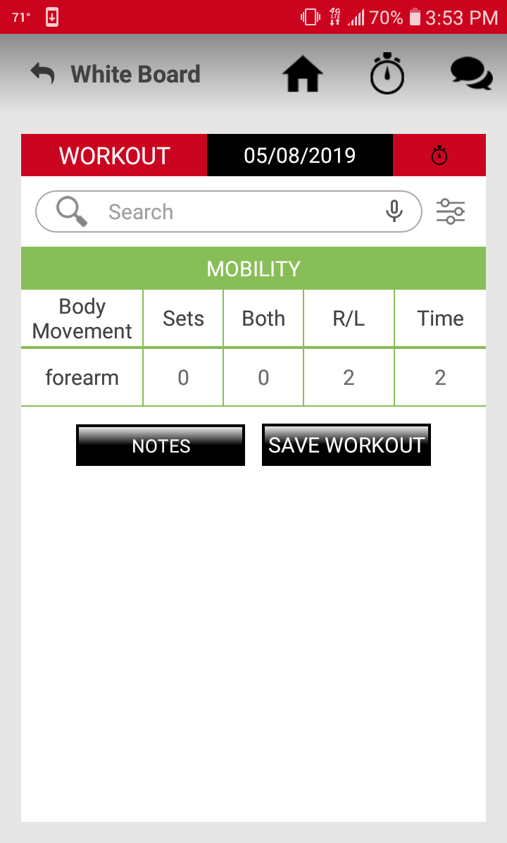
SEARCH BOX WILL PULL UP A DROPDOWN LIST OF EXERCISES
FUNCTIONALITY OF THE WHITE BOARD NEEDS TO BE FINALIZED

Slide 8

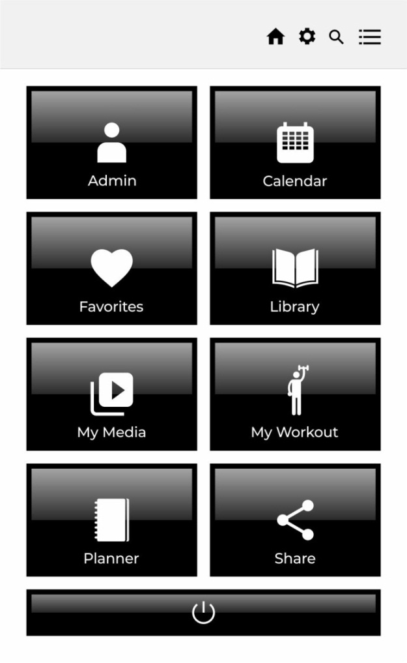
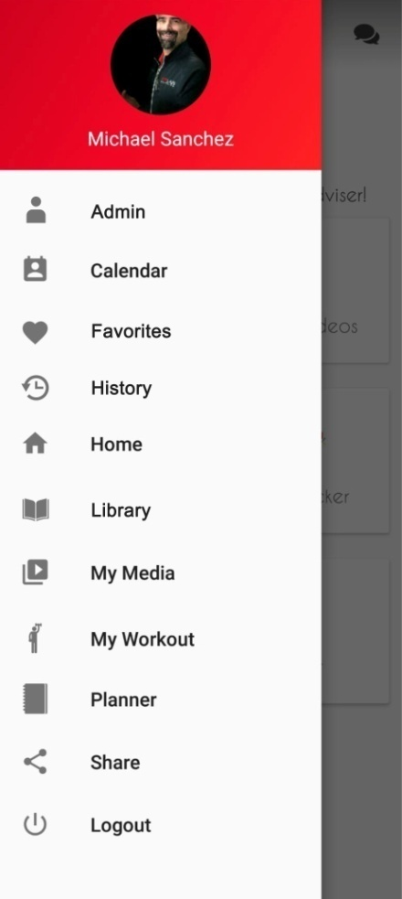
NEW MAIN MENU
User profile picture has to be displayed in circular shape
User Name has to be displayed below profile picture
These are the list of categories that the note screen should give accessibility to the User at the main menu , from the left corner.
Main Menu must have the clickable options as mentioned below
1. Admin 2. Calendar 3. Favorites
4.Library 5. My Media 6. My Workout 7. Planner 8. Share 9. Logout
( with respective icons next to it )
Replace with this skin,
And button options

Slide 9
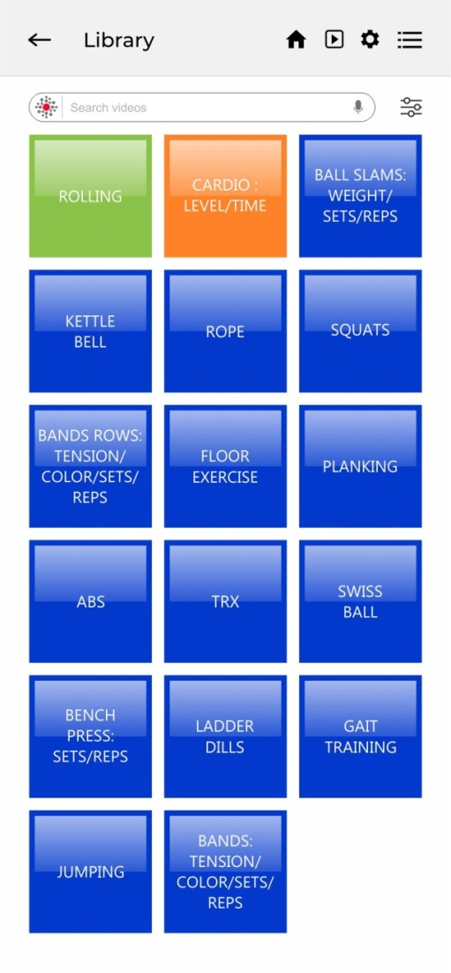
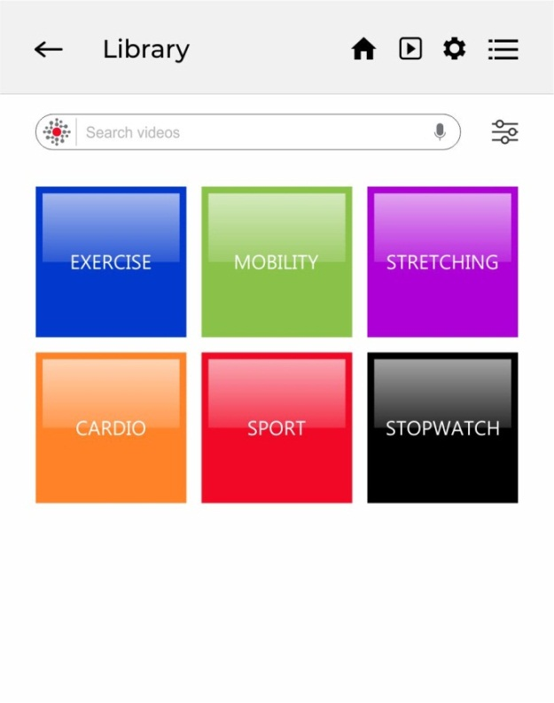
LIBRARY
NEXT
PAGE
MAIN MENU ->
FUNCTION ->
CATEGORIES ->
LIBRARY ->
VIDEOS ->
PLAYER

Slide 10
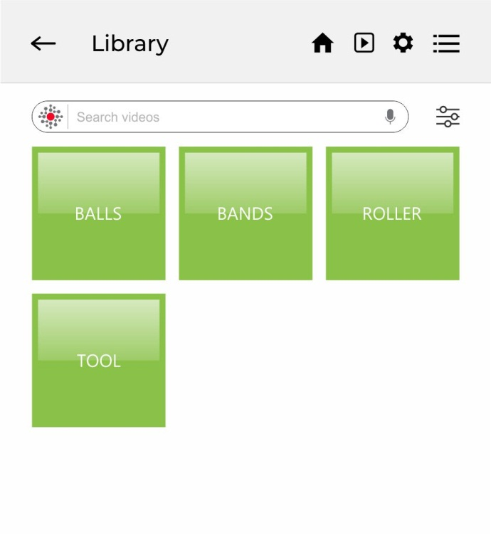
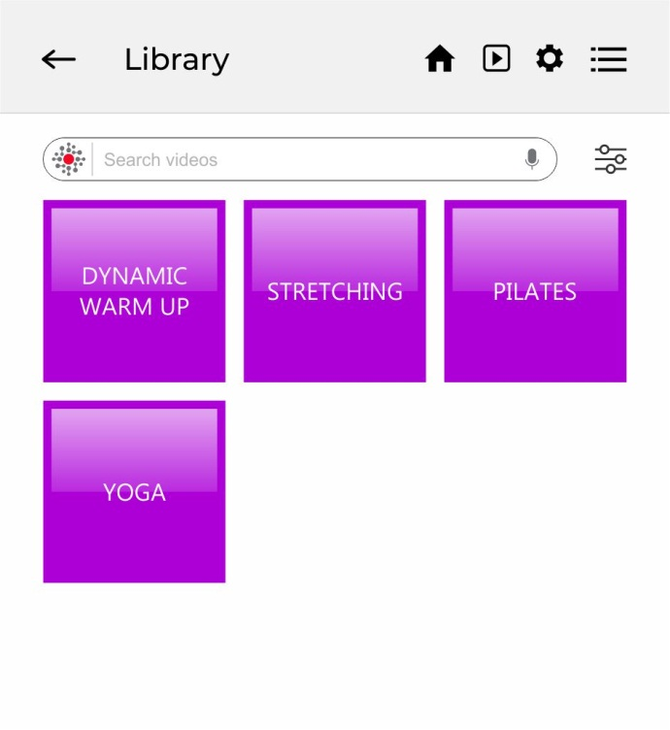

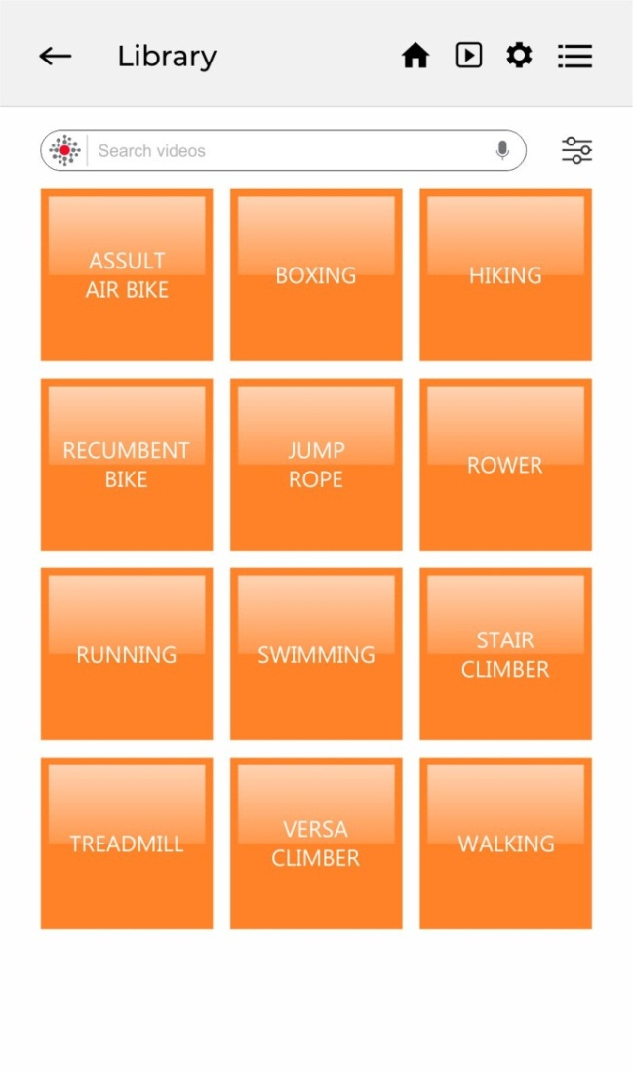
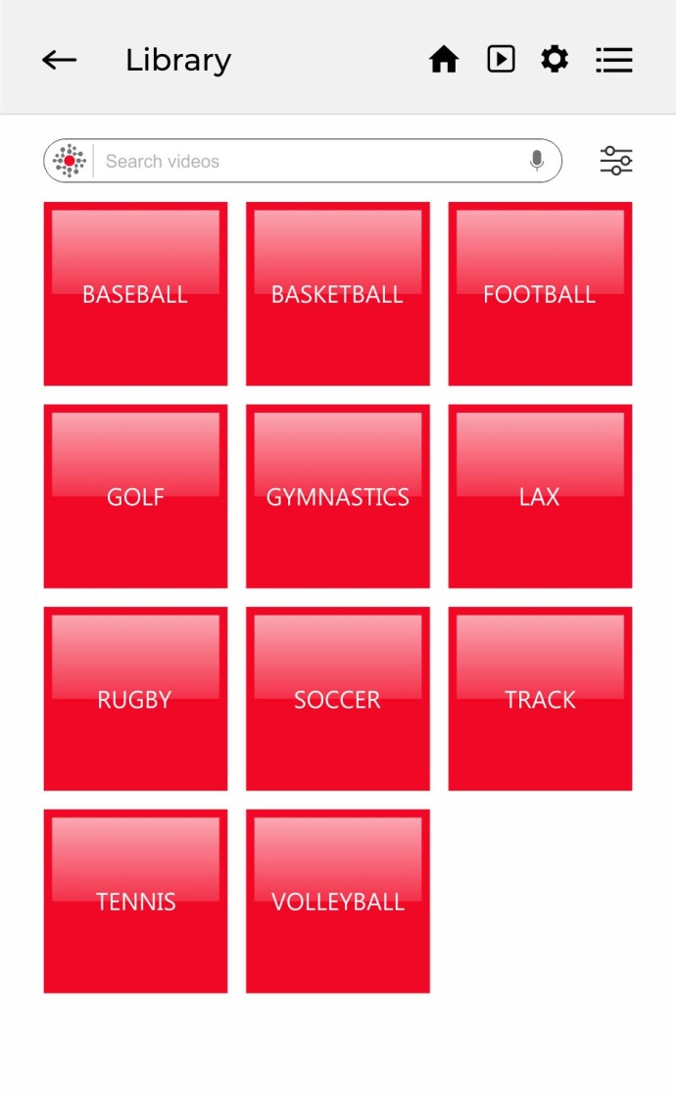
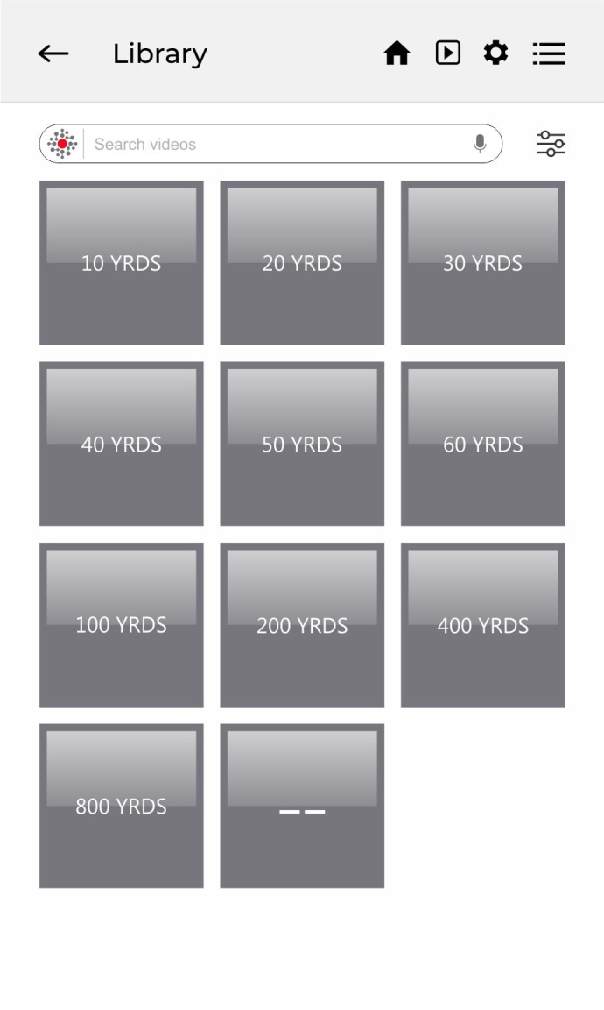
LIBRARY
EACH FUNCTION
(EXERCISE, MOBILITY, STRETCHING,
CARDIO, SPORT, STOPWATCH)
GOES TO COLOR CODED SECTION
OF CATEGORIES FOR THAT FUNCTION

Slide 11
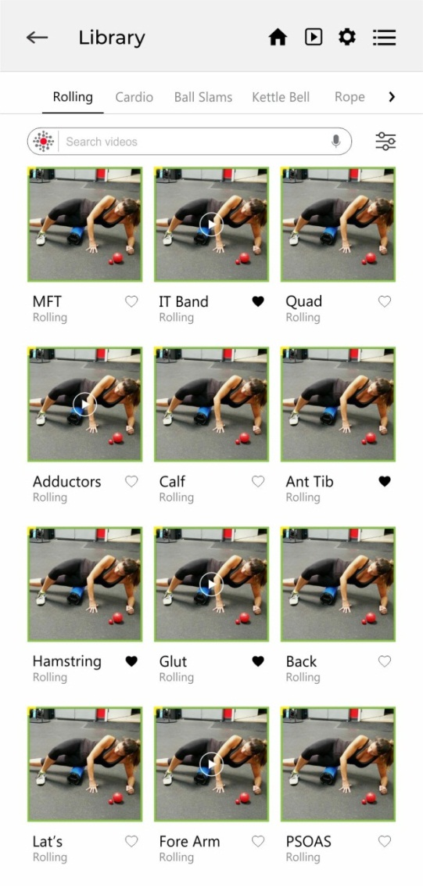

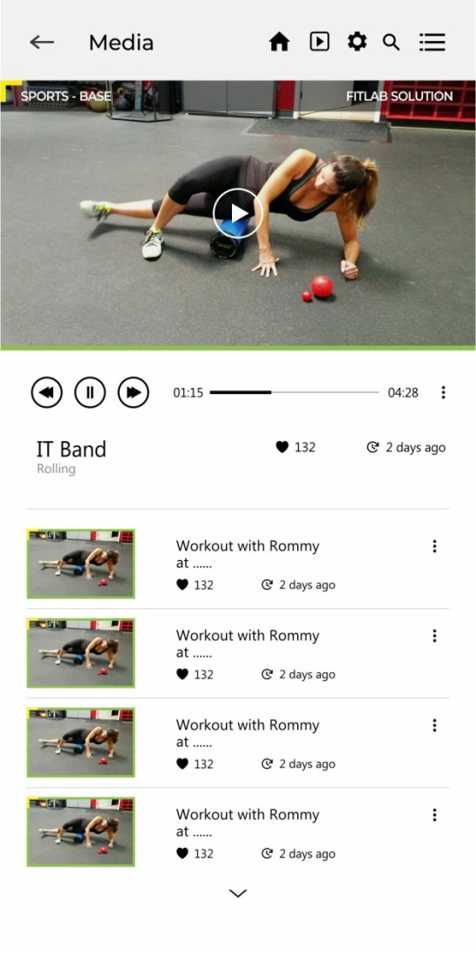
LIBRARY VIDEOS
CAN SWITCH
BETWEEN
CATEGORIES
FROM TOP
CATEGORIES ->
VIDEOS ->
PLAYER

Slide 12
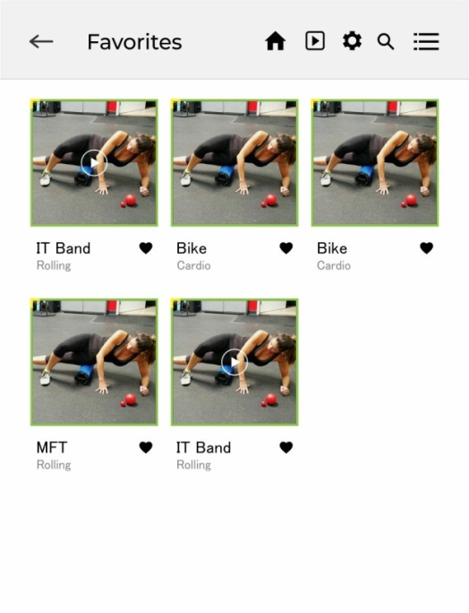


FAVORITES
USER CAN SELECT FAVORITES FROM LIBRARY,
ALSO PULL UP DIRECTLY FROM MAIN MENU

Slide 13

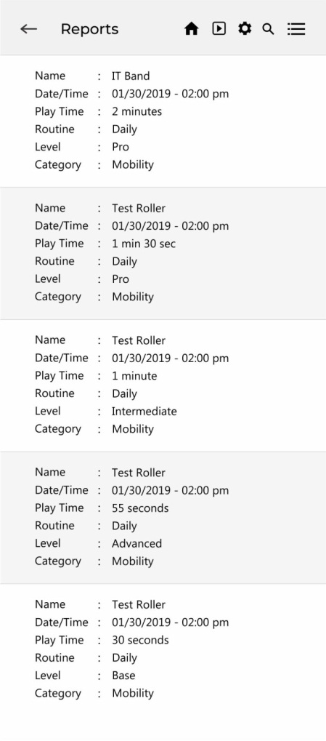
PLAYER
CAN FAVORITE FROM PLAYER
CAN PULL UP REPORTS
BASED ON WORKOUTS

